Slide 1
Postural Orthostatic Tachycardia Syndrome: Approach & Management
Satish R Raj MD MSCI FACC FHRS
Professor of Cardiac Sciences
Libin Cardiovascular Institute
Cumming School of Medicine
University of Calgary
North Florida Cardiovascular Symposium, Jacksonville FL
June, 2024

Slide 2
Disclosures
Associate Editor
Autonomic Neurosciences: Basic & Clinical (Elsevier)
Research Grants
Canadian Institutes of Health Research
Heart & Stroke Foundation
Dysautonomia International
Standing Up To POTS
Consulting/Honoraria
Theravance Biopharma – nOH Consulting
Amneal Pharma – nOH Consulting
Servier Affaires Medicales – POTS Consulting
Regeneron – POTS Consulting
Argenx BV – POTS Consulting
Antag Pharma – POTS Consulting
STAT Health – POTS Consulting

Slide 3
What is Postural Orthostatic Tachycardia Syndrome (POTS)?

Slide 4
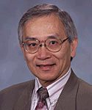
Postural Tachycardia Syndrome - Common Criteria
Orthostatic tachycardia > 30 bpm
>40 bpm in children
No orthostatic hypotension
ΔBP > 20/10 mmHg
Symptoms with upright posture
better with recumbence
Chronic symptoms > 3-6 months
No other obvious cause for orthostatic tachycardia
Phillip Low MD Mayo Clinic
Notes:
Tachycardia, palpitations, chest discomfort, tremor, SOB, headache, nausea, “brain fog”.
Exercise intolerance, extreme fatigue.

Slide 5
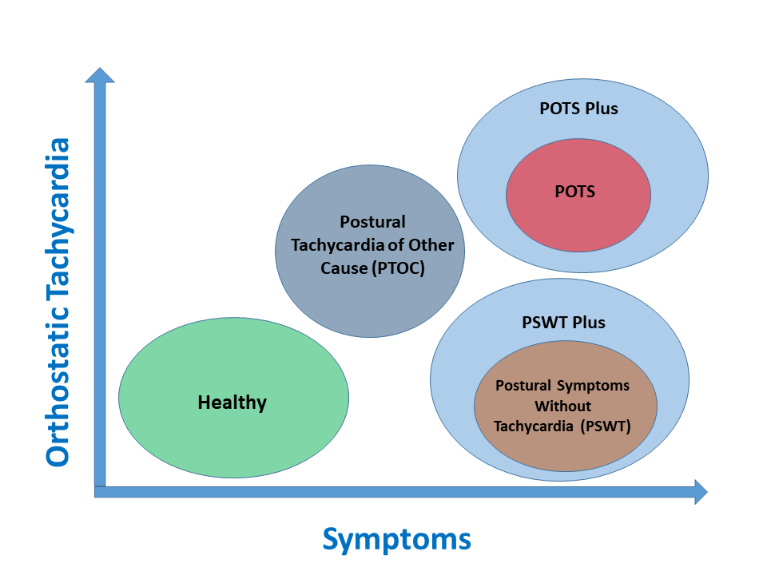
CCS 2019 POTS & Orthostatic Intolerance Schema
SR Raj et al. , Can J Cardiol 2020 Mar;36(3):357-372

Slide 6
CCS Clinical Criteria for POTS Plus
Same as for POTS and 1 or more:
Gastric emptying problems
Intractable vomiting
Severe constipation
Neurogenic bladder
Severe chronic pain
Intractable headaches
Significant flushing anaphylaxis syndromes
Severe food intolerances
Associated comorbidities:
Hypermobile EDS
Hypermobile spectrum DO
Mast cell activation DO
Chronic fatigue syndrome/ME
Celiac disease
Autoimmune DO
Chronic migraines
CSF leak
Mitochondrial mutation DO
MS
SR Raj et al. , Can J Cardiol 2020 Mar;36(3):357-372

Slide 7
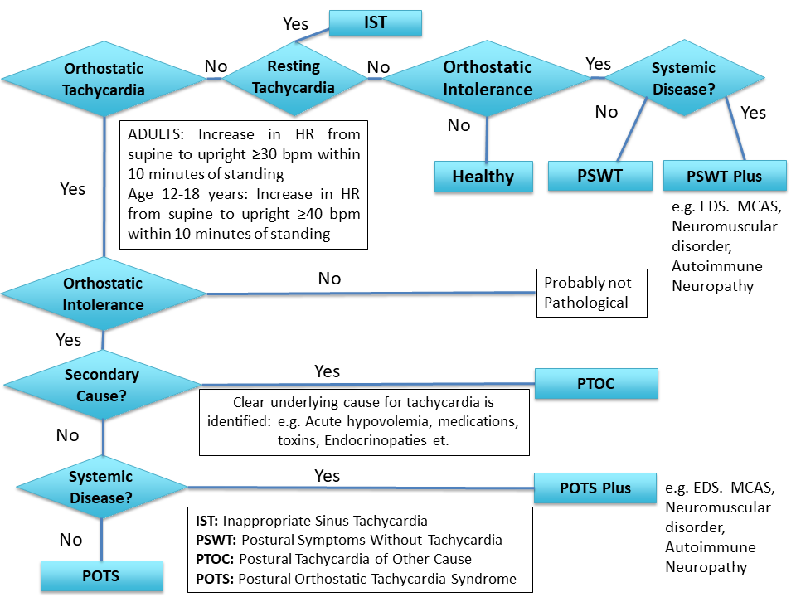
CCS 2019 POTS & Orthostatic Intolerance Schema
SR Raj et al. , Can J Cardiol 2020 Mar;36(3):357-372

Slide 8
POTS - Common Symptoms
Cardiac
Non-Cardiac
Rapid Heartbeat
Chest Discomfort
Short of Breath
Lightheaded
Exercise Intolerance
Mental Clouding
Headache
Nausea
Tremulousness
Fatigue
Sleep Complaints

Slide 9
Tilt Testing
Control
POTS
200
Heart Rate (bpm)
0
200
Blood Pressure (mmHg)
50
Tilt Angle (deg)
60
0
SR Raj, Indian Pacing Electrophysiol J. 2006;6:84-99
Notes:
30 min HUT.
POTS: Immediate HR increase and peaks to >170
Control: HR rises to just over 100
BP largely unchanged in both groups.

Slide 10
POTS: Feel awful when upright
SR Raj & RS Sheldon, Tilt Table Testing in
S Saksena & AJ Camm Electrophysiological Disorders of the Heart 2nd Ed. (2011)

Slide 11
The Face of POTS
BH Shaw et al., J Intern Med. 2019 Mar 12. doi: 10.1111/joim.12895

Slide 12
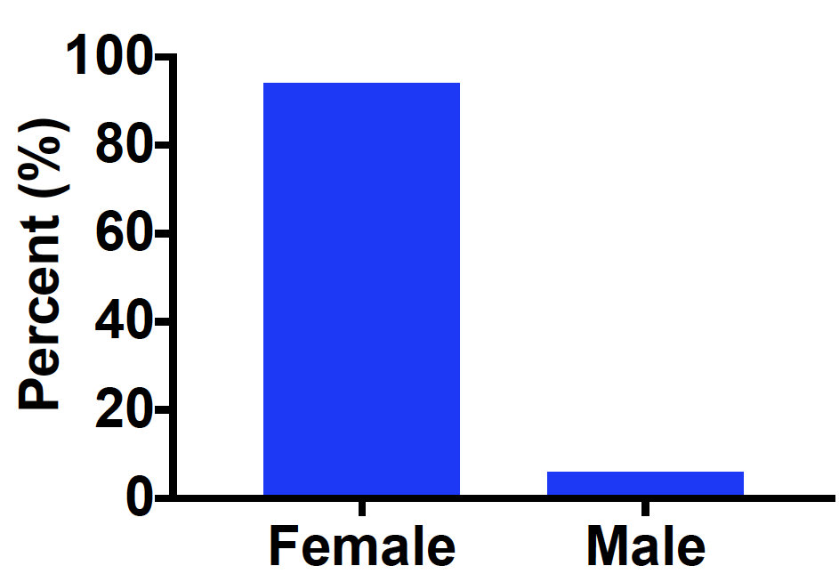
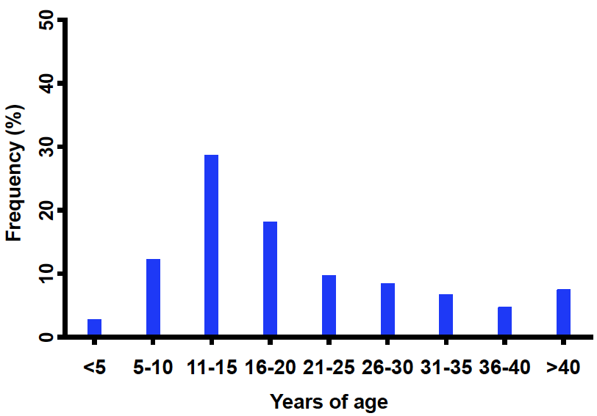
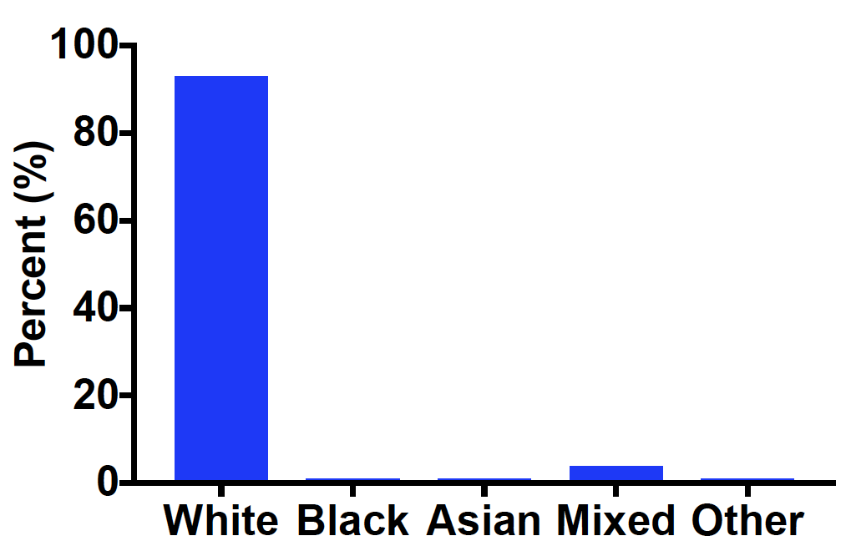
The Face of POTS
Sex
Age of symptom onset
POTS after age 18 years – 44%.
Peak age of onset is age 14.
Race
BH Shaw et al., J Intern Med. 2019 Mar 12. doi: 10.1111/joim.12895

Slide 13
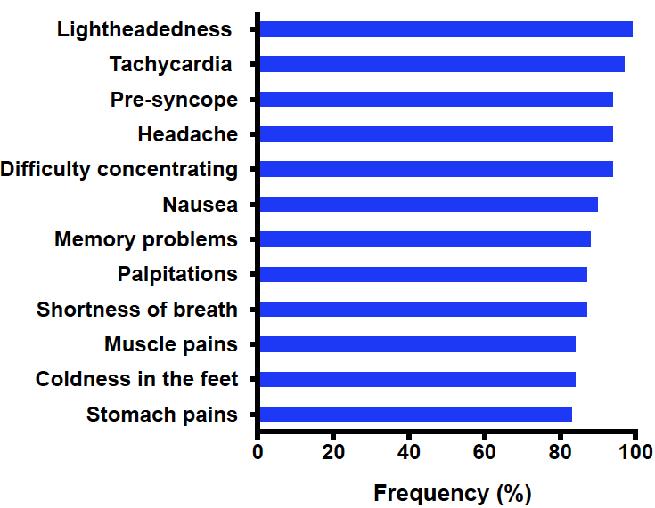
Common symptoms
BH Shaw et al., J Intern Med. 2019 Mar 12. doi: 10.1111/joim.12895

Slide 14
The Face of POTS
3276 (83%) had another medical condition in addition to POTS
Comorbidity
Migraine headaches (40%)
IBS (30%)
EDS (25%)
Asthma (20%)
Fibromyalgia (20%)
Raynaud’s phenomenon (16%)
Gastroparesis (14%)
Vasovagal syncope (13%
Comorbidity cont.
Inappropriate sinus tachycardia (11%)
Mast cell activation DO (9%)
Autoimmune disease (16%)
Hashimoto’s thyroiditis (6%)
Celiac disease (3%)
Sjogren’s syndrome (3%)
RA (2%)
Lupus (4%)
BH Shaw et al., J Intern Med. 2019 Mar 12. doi: 10.1111/joim.12895

Slide 15
Education
POTS can cause troubles with Education
As a result of their POTS:
89% of patients missed school
28% received home schooling
25% of patients have had to drop out of school
38% have had to delay or postpone enrollment or completion of university
BH Shaw et al., J Intern Med. 2019 Mar 12. doi: 10.1111/joim.12895

Slide 16
Quality of Life in POTS
Kanika Bagai

Slide 17
Health Related Quality of Life (SF-36) – Chronic Illnesses
Dialysis

Slide 18
Health Related Quality of Life (SF-36) – Chronic Illnesses
Dialysis
Modified from K Bagai et al., J Clin Sleep Med 2011

Slide 19
Is POTS … a Psychiatric Disorder?
Vidya Raj

Slide 20
Are POTS Patients Crazy?
No more than the General Population
Vidya Raj

Slide 21
Anxiety (ASI) Scores
Total score 0-64
Population 19.1±9.1
Panic disorder 36.4±10.3
POTS vs. pop: P=0.07
ADHD vs. pop: P=0.001
V Raj et al. , J Neurol Neurosurg Psychiatry 2009; 80: 339-344

Slide 22
CAARS DSM-IV Inattention Scores
V Raj et al. , J Neurol Neurosurg Psychiatry 2009; 80: 339-344

Slide 23
POTS Brain Fog – Problems even while Seated
Attention & Cognitive Processing
Executive Function
AC Arnold et al. , Clin Sci (Lond). 2015 Jan 1; 128(1): 39–45

Slide 24
Is the Heart Rate Response in POTS Psychological?

Slide 25
Is the HR Increase in POTS due to Blood Pooling in Legs or Anxiety?
Time (min)
S Masuki et al., J Appl Physiol 2007; 102: 896-903

Slide 26
POTS – What to Do?
Investigation & Treatment

Slide 27
POTS: Investigations
History & Physical Examination
Orthostatic Vital Signs – 10 min
CBC, BMP, sTSH, (cortisol)
Other Tests as Determined by Initial Evaluation
Autonomic Reflex Testing
Echocardiogram
Blood Volume Assessment
Exercise Capacity Assessment

Slide 28
POTS: Non-Pharmacological Treatment Approaches
Dietary Salt
Compression Garments
Exercise

Slide 29
Dietary Salt in POTS: Summary
EM Garland et al., JACC 2021;77:2174-2184

Slide 30
Dietary Salt in POTS: Practical Tips
Target
Water - 3L/day (water bottle)
Salt - 8-10g/day
Teaspoon Approach
2 teaspoons of salt in zipped snack bag in AM
Get this ingested through the day
Most add it to foods
“Salt Water” Shots
Salt Tablets – only if diet not tolerated
Regular - lots of nausea; fairly inexpensive
Gel Coated (“Vitassium”) – better tolerated; can get expensive

Slide 31
Compression Garments – They Work
K Bourne et al., JACC 2021;77: 285-296

Slide 32
Compression Garments – Symptoms Improve
K Bourne et al., JACC 2021;77: 285-296

Slide 33
Exercise in POTS - Benefits
Short-term exercise training in POTS
Increases fitness levels
Increases blood volume
Cardiac Remodeling
Normalizes Sympathetic Activity
Decreases Orthostatic Tachycardia
Improves Quality of Life
Qi Fu et al., JACC 2010;55:2858-68

Slide 34
Exercise in POTS – How To?
Focus on Aerobic Activity
Some resistance training focused on thighs
Must be Regular
Every other day (4/week)
30min/session -> 45-60min/session
NO UPRIGHT EXERCISES
Rowing machines
Recumbent Cycles
Swimming
Takes up to 6 weeks to start seeing benefits
Qi Fu et al., JACC 2010;55:2858-68

Slide 35
POTS: Pharmacological Treatment Approaches
IV Saline
DDAVP
Midodrine
Propranolol
Ivabradine
Pyridostigmine
NETi/SNRI

Slide 36
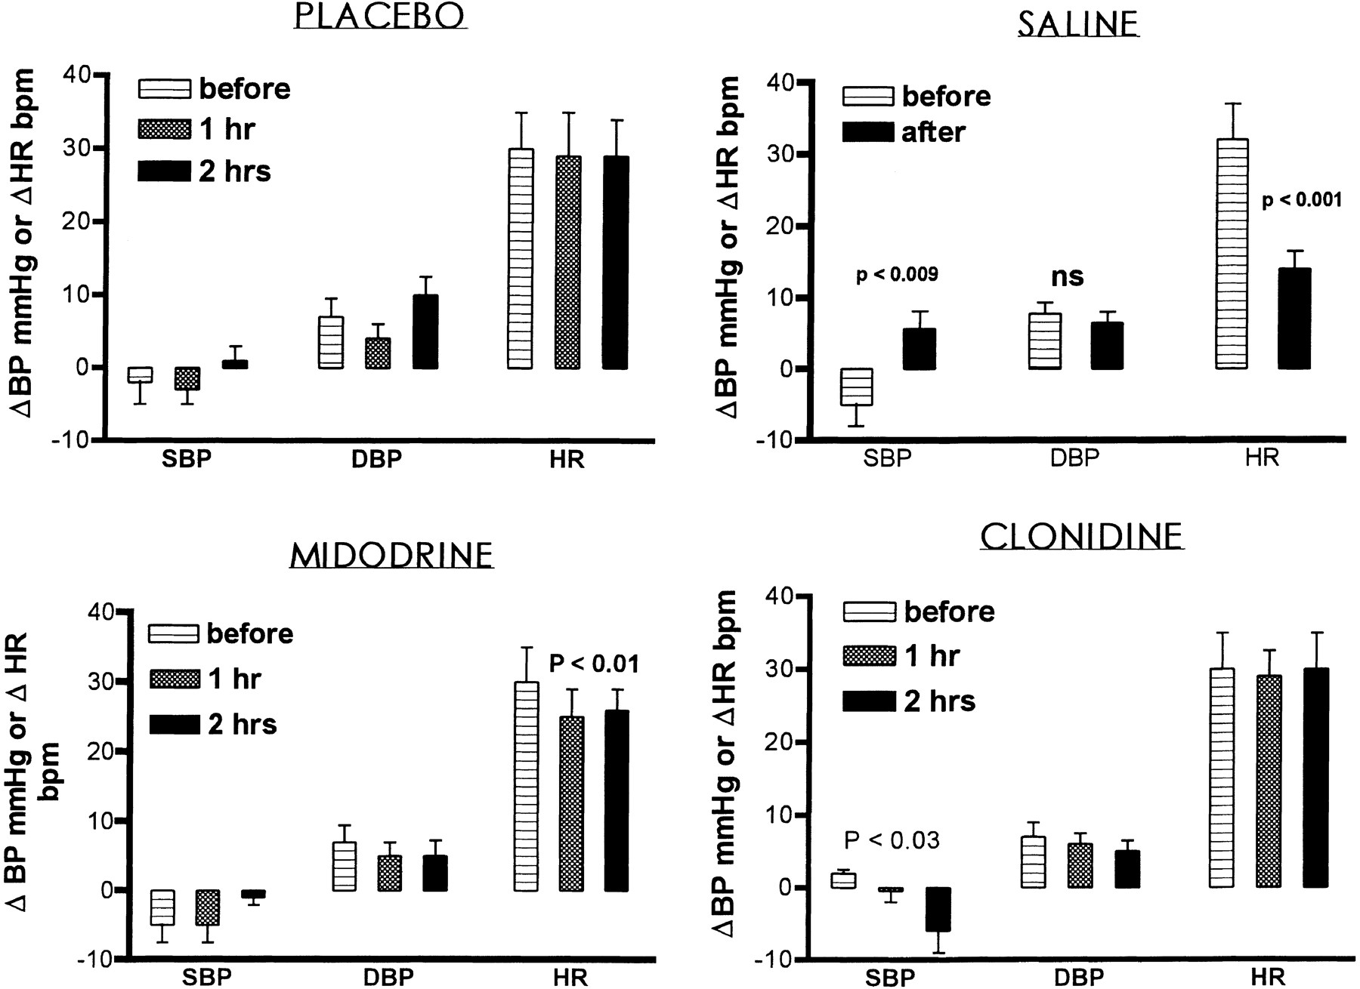
IV Saline (1L) Acutely Decreases Orthostatic Tachycardia…a LOT!!
G Jacob et al. Circulation 1997;96:575-580

Slide 37
IV Saline Recommendations
COR | LOE | Recommendation
IIa | C | It is reasonable to treat patients with POTS who have short-term clinical decompensations with an acute intravenous infusion of up to 2 L of saline.
III | E | Regular intravenous infusions of saline in patients with POTS are not recommended in the absence of evidence, and chronic or repeated intravenous cannulation is potentially harmful.
R Sheldon et al. Heart Rhythm 2015; 12(6):e41-63

Slide 38
DDAVP+H₂O reduces standing HR
ST Coffin et al., Heart Rhythm. 2012;9:1484-90

Slide 39
Midodrine Decreases Orthostatic Tachycardia…a little bit.
Jacob, G. et al. Circulation 1997;96:575-580

Slide 40
Beta-Blockers in POTS
PRO
Intuitively appealing
High HR -> Lower it
CON
Stewart et al. studied IV esmolol and found that it DID NOT improve orthostatic tolerance
Many patients report “intolerance to beta-blockers”

Slide 41
Propranolol 20mg lowers Orthostatic Tachycardia
Orthostatic Increase in HR
Standing HR
SR Raj et al. Circulation 2009;120:725-734

Slide 42
Propranolol Improves Symptoms…
SR Raj et al. Circulation 2009;120:725-734

Slide 43
…but Less is More
Just a little bit!
SR Raj et al. Circulation 2009;120:725-734

Slide 44
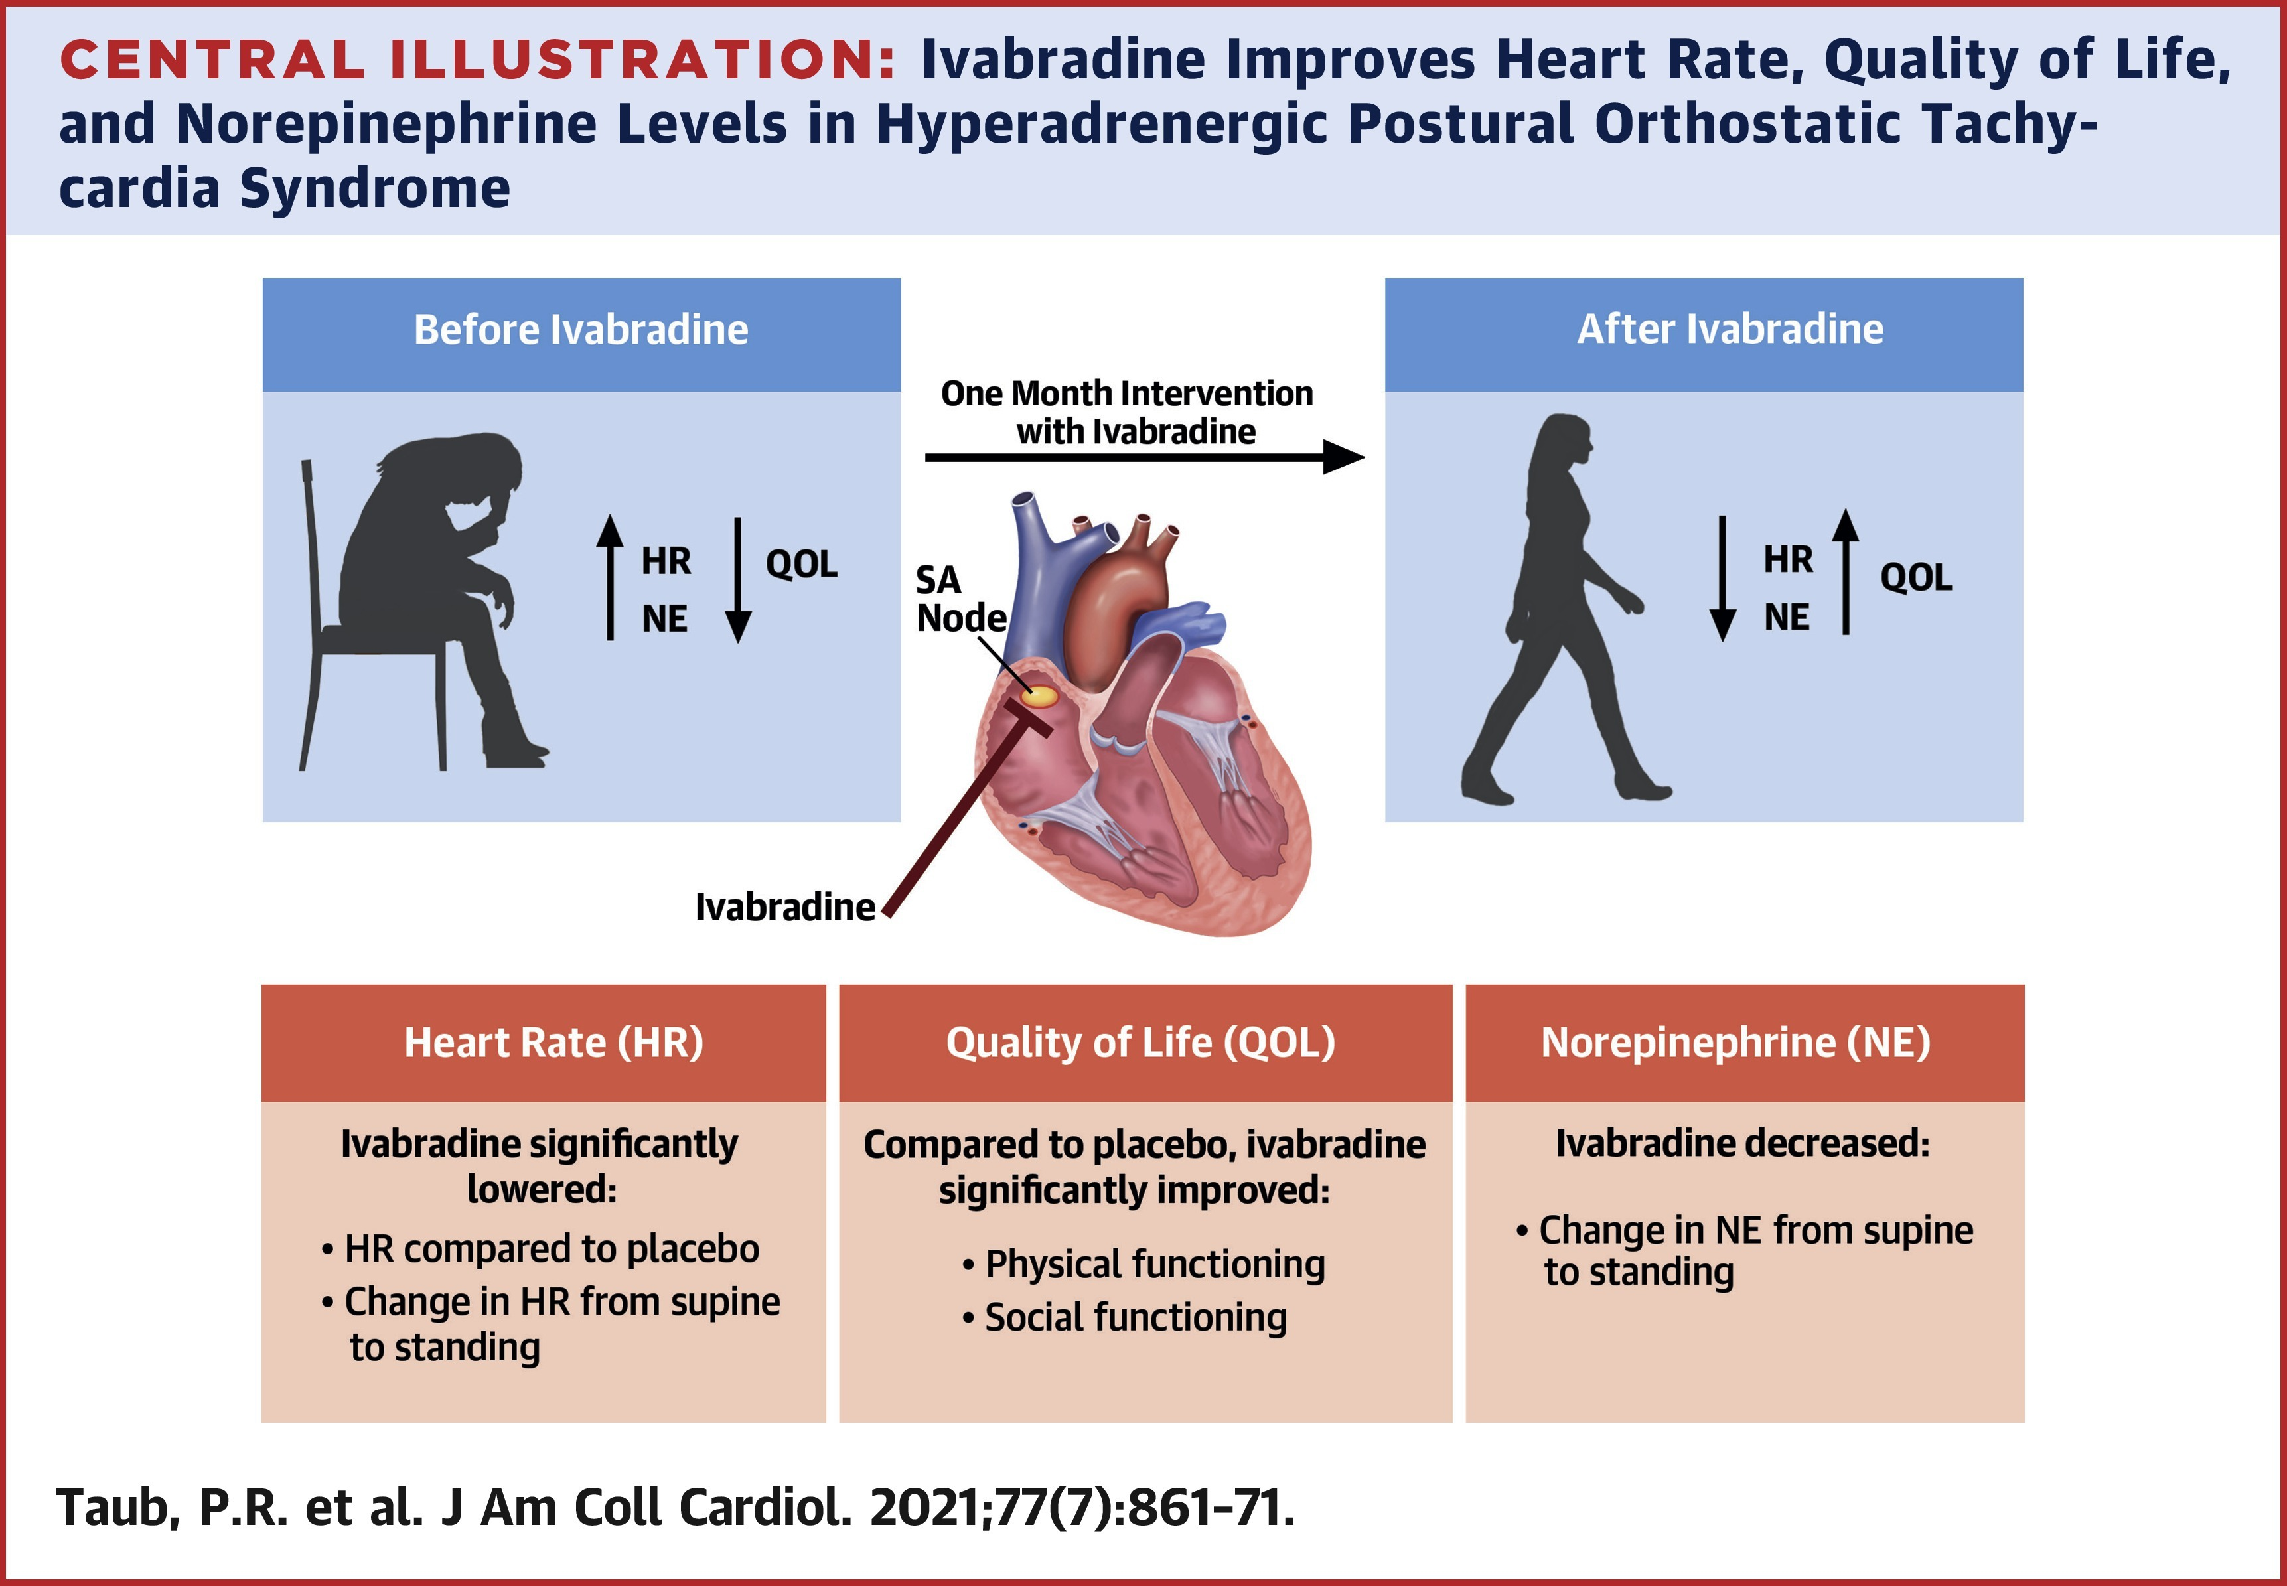
Ivabradine in POTS – Crossover RCT
P Taub et al., JACC 2021;77(7):861-871

Slide 45
Acetylcholinesterase Inhibition
Pyridostigmine
Peripheral AChEI
Increases availability of synaptic ACh
Ganglionic Nicotinic Receptor
↑ SNS & ↑ PNS
Postganglionic Muscarinic Receptor
↑ PNS
Might decrease tachycardia in POTS

Slide 46
Acetylcholinesterase Inhibition
Standing Heart Rate
Symptoms
SR Raj et al., Circulation 2005;111:2734-2740

Slide 47
Norepinephrine Transporter Inhibition (e.g. SNRI drugs)
EA Green et al., JAHA 2013;2:e000395

Slide 48
Norepinephrine Transporter Inhibition (e.g. SNRI drugs)
EA Green et al., JAHA 2013;2:e000395

Slide 49
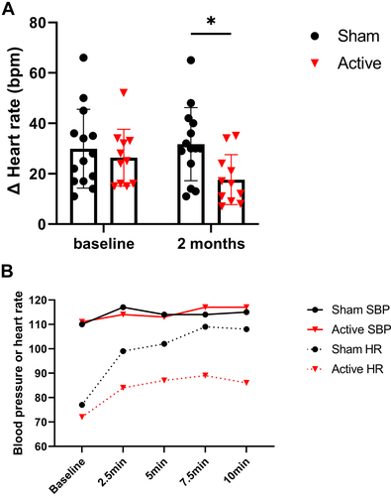
NEW: Vagal Nerve Stimulation
Stavros Stavrakis et al. J Am Coll Cardiol EP 2023;

Slide 50
POTS – Take Home Messages
POTS
chronic disorder associated with significant disability
Syndrome…not one disease
Multiple pathophysiologies
Treatment
Exercise
Volume expansion
Heart rate control
Manage the “living with a chronic illness”

Slide 51
Questions?

